Slide 1

ONLINE BARBERSHOP MANAGEMENT SYSTEM
PG-DAC SEP 2020
Project By-
1) Mithil Chavan (2029)
2) Vaibhav Deokar (2035)
3) Pranav Sakhare (2152)
GUIDE NAME: Mr. Akshay Parab

Slide 2
Project Name
ONLINE BARBERSHOP MANAGEMENT SYSTEM

Slide 3
ABSTRACT:
The online Barbershop Management system can be used by customers to book their appointments online, without having to go to the actual shop.
This system is enabled by the internet which connects all the Barbershops in a particular area and the customers.
As per this system, the customer visits the website, browses through the various shops in desired areas, prices and services available in various shops and selects and book the appointment of service he or she needs.
These appointments will then be confirmed by the shop owners and the respective slots will be booked for the respective customer.

Slide 4
. INTRODUCTION:
The Online Barbershop Management System is a program that will be capable of inputting data and retrieving data to support the booking process.
The program will have all necessary details of various shops in particular areas, and services offered by those shops along with prices. The Online Barbershop Ordering System is the typical booking and data retrieving system. How the program would work in typical conditions is a customer or shop owner would access the database and enter the required information.
The goal of the program is to develop a data collection that would allow new customers and new shop owners to input their personal data ( name, address, number, email, services, prices etc. )

Slide 5
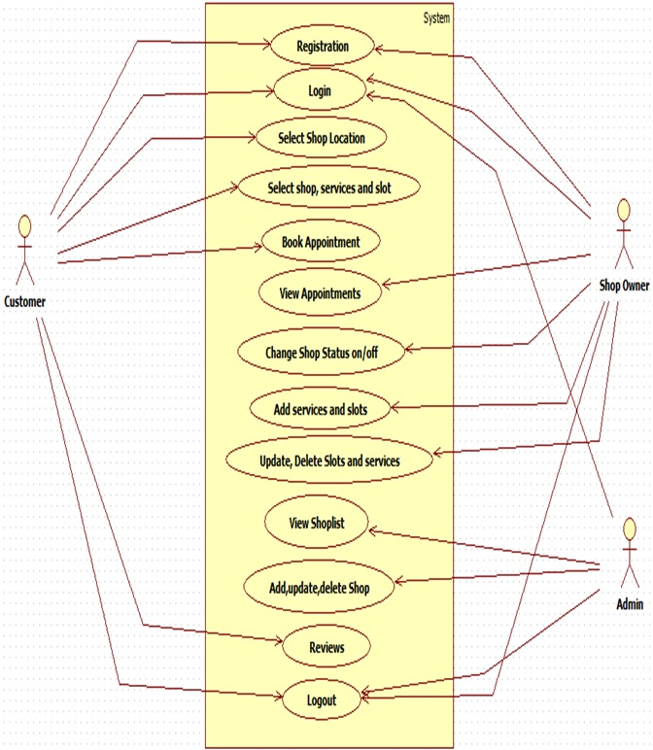
UML DIAGRAM

Slide 6
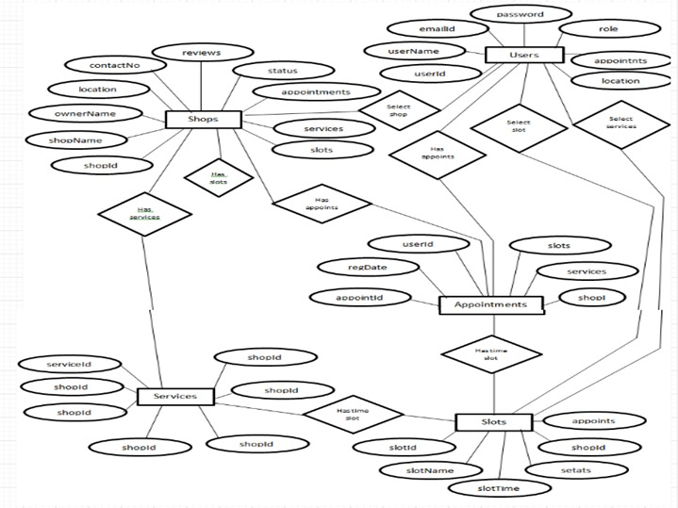
ER-DIAGRAM:

Slide 7
PURPOSE:
Login For Admin
Manage shop list and shop details
Login for Shop Owner
add the details of shop & services, prices to the list
Edit & update the services & slots of the list
Customer Registration
Customer Login
Customer Booking
Customer Booking confirmation

Slide 8
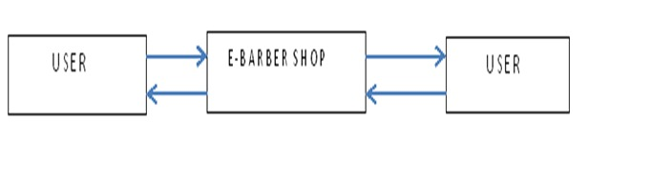
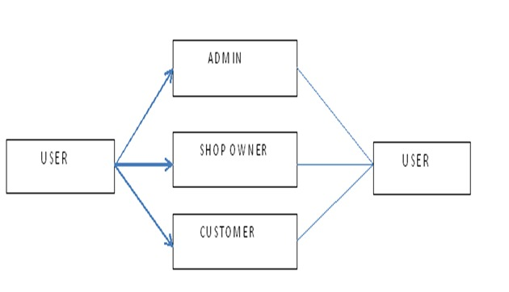

Slide 9
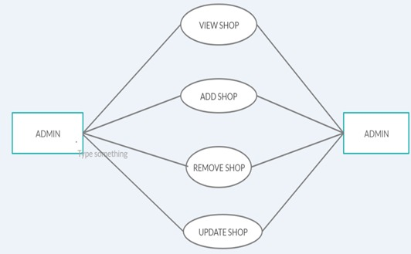
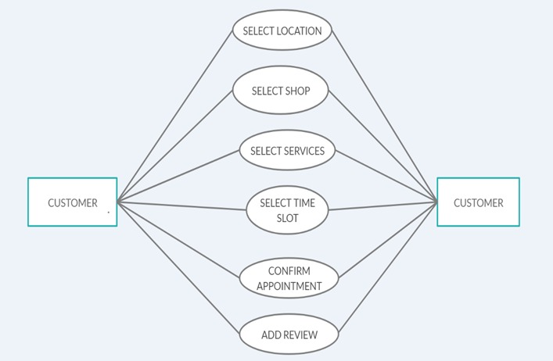

Slide 10
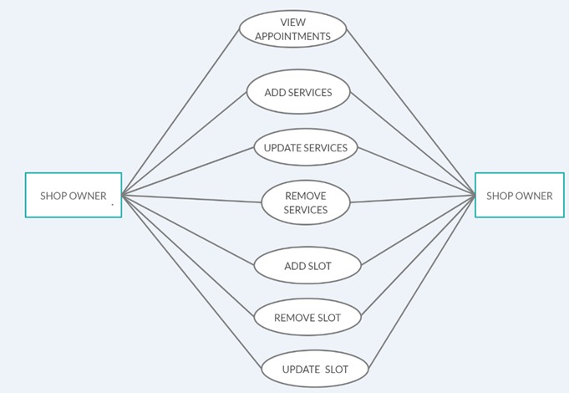

Slide 11
SCOPE:
Online Barbershop Management system will be a web based application whose main language of programming will be Java.
Its main aim is to simplify and improve the efficiency of the ordering process for both customer and shop owners, minimize manual data entry, ensure data accuracy and security during order booking process.
It also focuses on reducing the health risks during pandemic situation. Customers will also be able to view various shops and their services and be able to have a confirmation that the booking was done correctly.

Slide 12
FEATURES:
Online Booking System.
Provision for Shop owners to perform various operations like add, edit, update the service and prices.
Easy lookup of registered shops on portal.
Simple, fast and convenient .
Availability of all the shops in the areas.
An online portal is ready to be viewed by people in various areas.

Slide 13
BENEFITS:
• This Online-Barber Shop system is fully functional and flexible.
• It is very easy to use.
• This system helps customer to book appointment at barber shop.
• It saves lot of time of customer.
• It increases the efficiency of the management at offering quality services to the customers.

Slide 14
CONCLUSION:
Online-Barber Shop system is responsible for providing best services, flexible time slot and daily services and time changes with the affordable prices on specified. This approach also offers an added advantage that customers can select a specified time slot of the day for the appointments of shop. The application provides facility to add/remove/slot and services items at shop. It also provides facility where customers can mention their queries/complaints in reviews.

Slide 15
REQUIREMENTS:
SOFTWARE REQUIREMENT
1. Windows 10
2. MySQL Database
3. Spring Tool
4. Google Chrome
5. Apache Tomcat server
HARDWARE REQUIREMENT
Server Side:
Processor: Intel Dual Core
HDD: Minimum 500GB Disk Space
RAM: Minimum 2GB
OS: Windows 8.1Database: MySQL.
Client Side (minimum requirement):
Processor: Intel Dual Core
HDD: Minimum 80GB Disk Space
RAM: Minimum 1GB
OS: Windows 7.

Slide 16
REFERENCES
https://www.floydsbarbershop.com/
http://w3schools.com/ https://getbootstrap.com/docs/5.0/getting-started/introduction/

Slide 17
THANK YOU

